Slide 1
Miss Jewkes’ Reception class
Home learning
Week beginning 29-06-2020
Week beginning 06-07-20

Slide 2
Reception activities
Hello, in this Powerpoint you will find activities for maths and literacy.

Slide 3
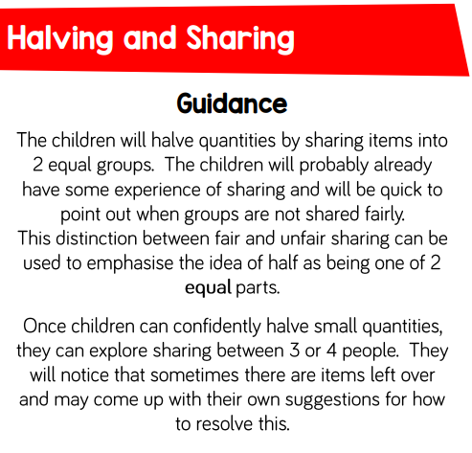
Maths support WB 29-06-20

Slide 4
Maths support

Slide 5
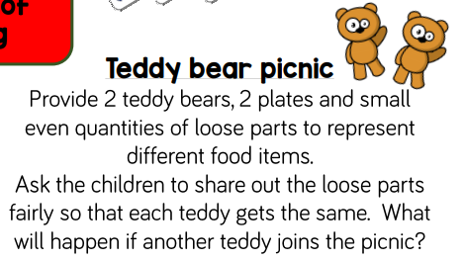
Maths support

Slide 6
Maths support
Check out the halving PowerPoint on the school webpage.
Complete a halving worksheet, found in your home learning packs, each day.

Slide 7
Maths support Odds and evens WB 060720

Slide 8
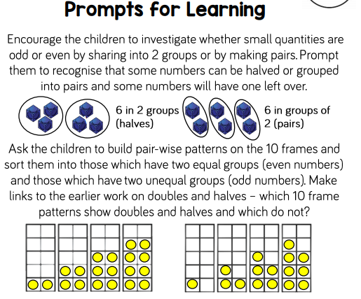
Maths support Odds and evens

Slide 9
Maths support Odds and evens

Slide 10
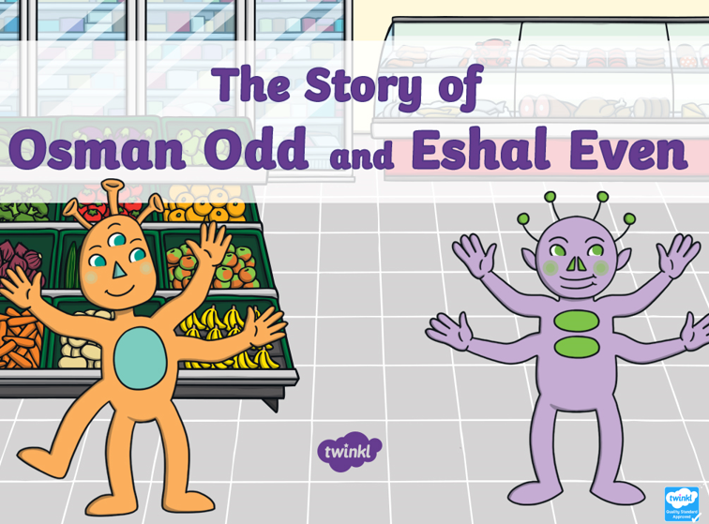
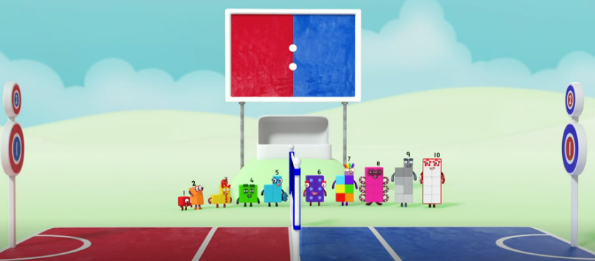
Maths support
Check out the odds and evens PowerPoint on the school webpage.
Complete a odd and even worksheet, found in your home learning packs, each day.
Numberblocks Series 2 episode Odds and Evens is a great video to watch before completing Odd and Even work. Check it out on iPlayer.
https://www.bbc.co.uk/iplayer/episode/b08r2l4d/numberblocks-series-2-odds-and-evens
Have a look at this video on BBC
https://www.bbc.co.uk/bitesize/topics/zknsgk7/articles/zt4jj6f

Slide 11
Phonics
We have learnt all our phase 2 and phase 3 phonemes in reception.
Continue to practise reading and writing the phonics high frequency words and sounds we have learnt at home. You can use Phonicsplay.co.uk for fun phonics games.
In your home learning pack there are some phonics games to play.
Can you make up your own phonics game?

Slide 13
The Rainbow fish – Marcus Pfister
The Rainbow fish is a lovely book all about sharing. I have sent home a number of literacy based activities around the book.
You can access a digital copy of the book here:https://docs.google.com/viewer?a=v&pid=sites&srcid=YWJwbnByLm9yZ3xlbmdsaXNofGd4Ojc1ODJjMzRiN2FiNmJkMWQ
Or watch it be read here: https://youtu.be/r9mryuEKkKc
Or here https://www.youtube.com/watch?time_continue=8&v=Nb2msIQo6TI&feature=emb_logo
In your home learning packs I have outlined what activities to do in what order. These don’t have to be completed over a week and can be spread out over the two weeks with phonics/maths/other activities in between.

Slide 14
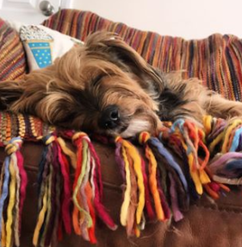
In the home learning paper packs I have sent 2 weeks worth of learning. Then it’ll be time for Reception class to return for a week before summer holidays begin. I’m so excited to see the children return. During that week we will be doing lots of social and emotional activities with our friends and having lots of good Reception fun. Don’t forget to read, keep active with Joe Wicks, GoNoodle, Cosmic Yoga or a nice walk. Stay safe and keep smiling, Miss Jewkes & her home learning helpers Biffy the Dog and Peralta the dragon.

