Slide 1
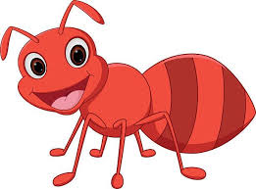
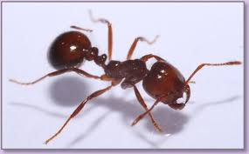
Ant
I am an ant.
[Children repeat.]
Let’s count my legs.
[Children repeat.]
I’ve got 1 and 2, 3 and 4, 5 and 6. SIX! I am an ant.
[Children repeat.]
I’ve got six legs!
[Children repeat.]

Slide 2
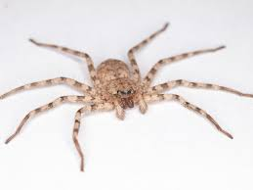
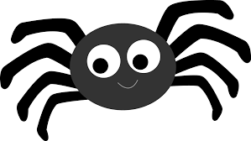
Spider
I am a spider.
[Children repeat.]
Let’s count my legs.
[Children repeat.]
I’ve got 1 and 2, 3 and 4, 5 and 6, 7 and 8. EIGHT! I am a spider. [Children repeat.]
I’ve got eight legs! [Children repeat.]

Slide 3
What animals can you come up with for the different number of legs?

Slide 4
Animal legs
I am an ant.
[Children repeat.]
Let’s count my legs.
[Children repeat.]
I’ve got 1 and 2, 3 and 4, 5 and 6. SIX! I am an ant.
[Children repeat.]
I’ve got six legs!
[Children repeat.]
I am a spider.
[Children repeat.]
Let’s count my legs.
[Children repeat.]
I’ve got 1 and 2, 3 and 4, 5 and 6, 7 and 8. EIGHT! I am a spider. [Children repeat.]
I’ve got eight legs! [Children repeat.]

